Slide 1
CIS5014 Port 1 – Populous 2
ST20252897

Slide 2
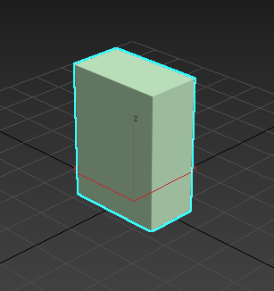
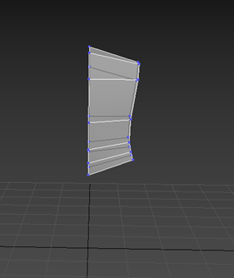
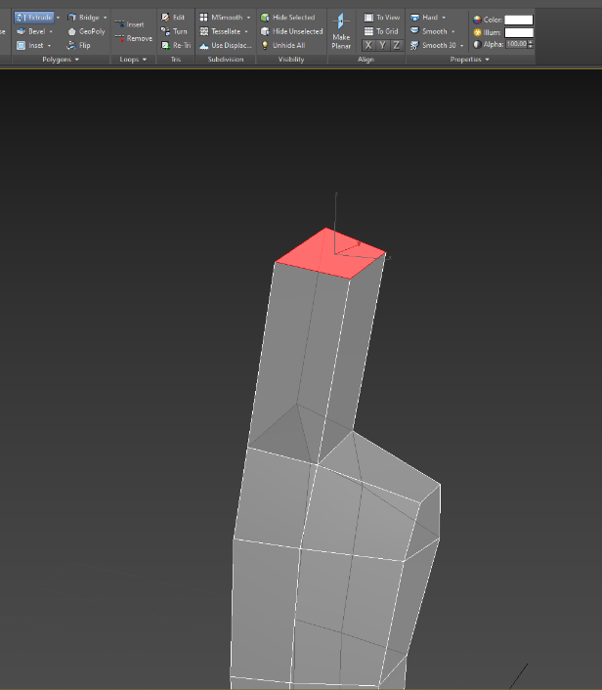
3D Modelling
Based on some research I had done beforehand, I decided it would be much easier for me to only model half of the character and then use a Symmetry modifier to duplicate what I had done for a full symmetrical model.
Example: Character model
My character model started as a simple box object. I gave it a few height segments to allow me to easily model with it, and then added an Edit Poly modifier.
I began using the Vertex mode to select vertexes and begin shaping them into a general torso shape. I had to use the Swift Loop tool to create more geometry to work with as I went on.
I made sure to remove the polygon on the inside of the torso.
Using the extrude tool I then brought an area for the neck/face out. I used another extrude to bring out the face and sorted out the shaping of the chest.
File Types:
.max

Slide 3
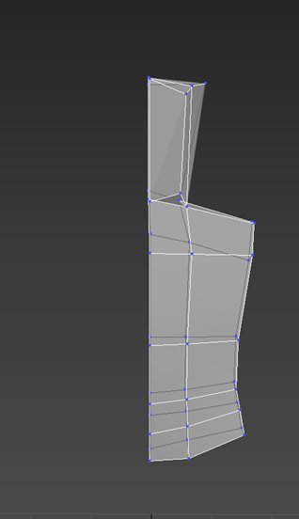
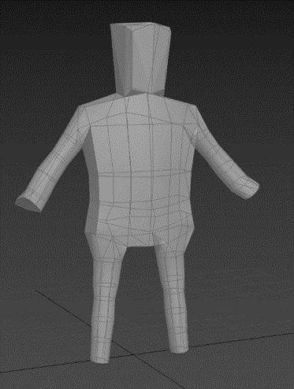
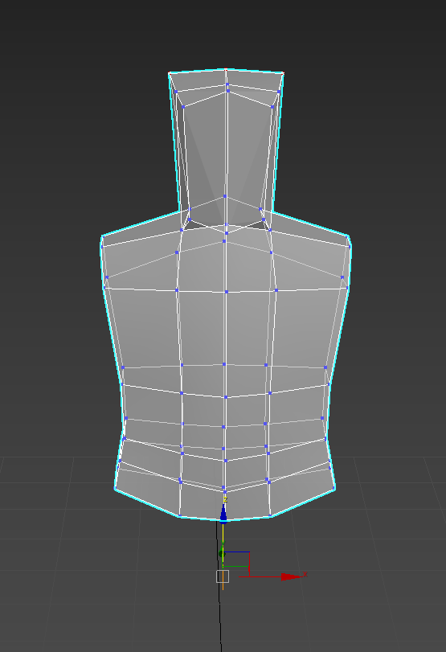
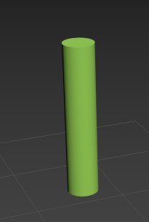
I selected all the vertices on the left-hand side, set them to X=0 and then used the Planar tool to make sure that they were all flush with the origin.
This allowed me to then use the Symmetry modifier to convert the model into a full torso, however I did have to tweak some of the shaping of the torso later to better fit the addition of limbs.
My arms and legs all started as cylinders. I modelled each one very simply with an edit poly, selecting rings of vertices and moving and scaling them to roughly look like an arm and a leg. I then used the symmetry tool and the detach tool to create 2 separate, symmetrical versions of each limb. I then attached these to the body, making sure to remove the inner polygons.
I decided to not have fingers or toes as I felt it did not fit the style I was aiming for.

Slide 4
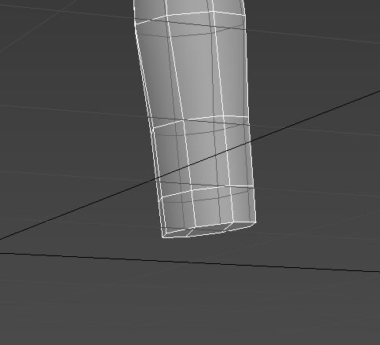
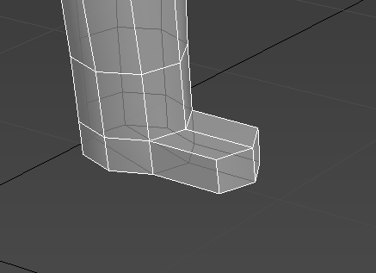
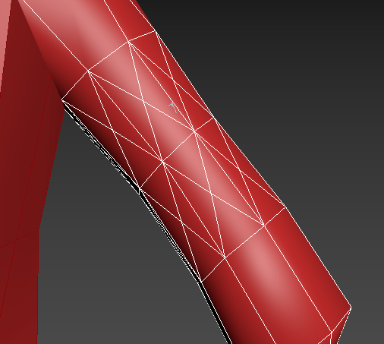
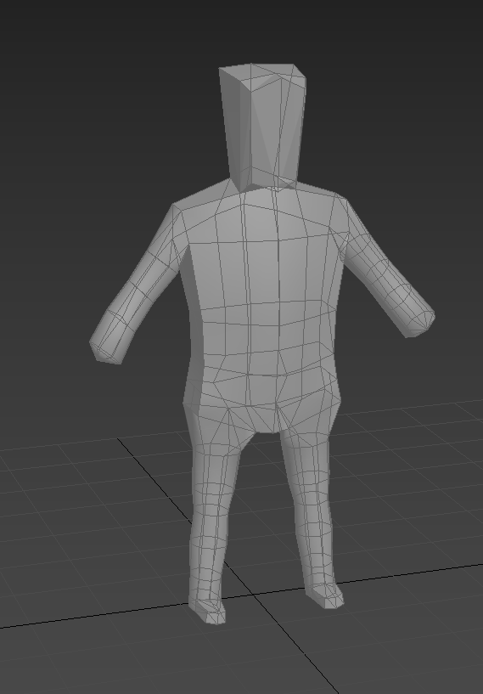
I also used the tesselate tool on some polygons near the elbow of the character. This was for later on when I animate the character.
I used the extrude tool to create some ‘Paddle Feet’
Up to this point I had the body parts and the torso as a singular object. I decided to change this for the purpose of stylizing my animations in a way that is similar to old fighting games. I used the Cap Holes modifier to fill the gaps where limbs used to connect, making sure to tick ‘Triangulate Polys’ to make sure no ngons are generated.

Slide 5
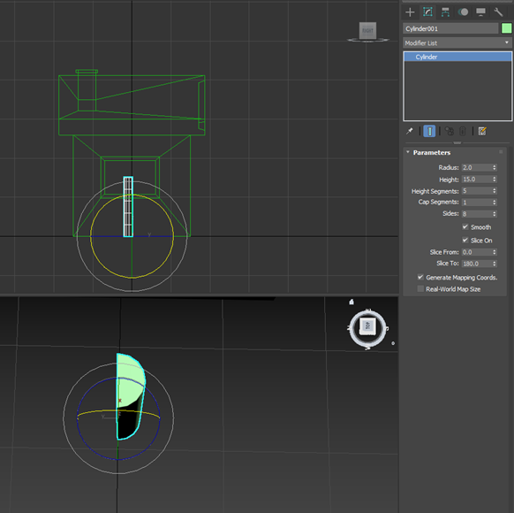
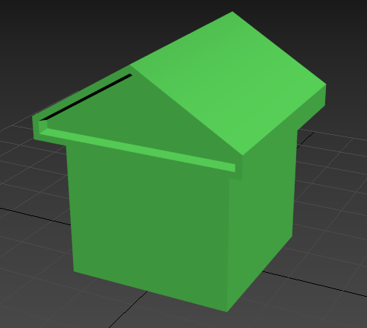
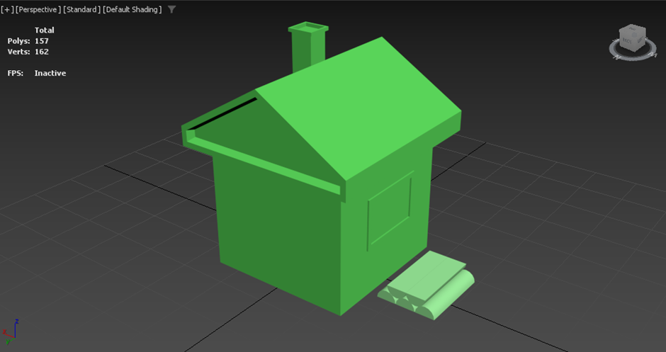
Example: Basic house model
A lot of techniques I used for the house are similar to that of the character. I will only be talking about any different tools or techniques I used.
To achieve this feature on the roof I used the Inset tool to create a small outcrop and then used the Bevel tool on the inner polygon to make a Mausoleum-Type roof. I then used the P-Connect tool to remove any Ngons by using its Connect Vertices mode.
I used the Slice option on a cylinder to create a piece that will function as a wooden log in the final product. I then instanced it and created a pile of them so that any changes I make to the original will automatically move onto the other logs.

Slide 6
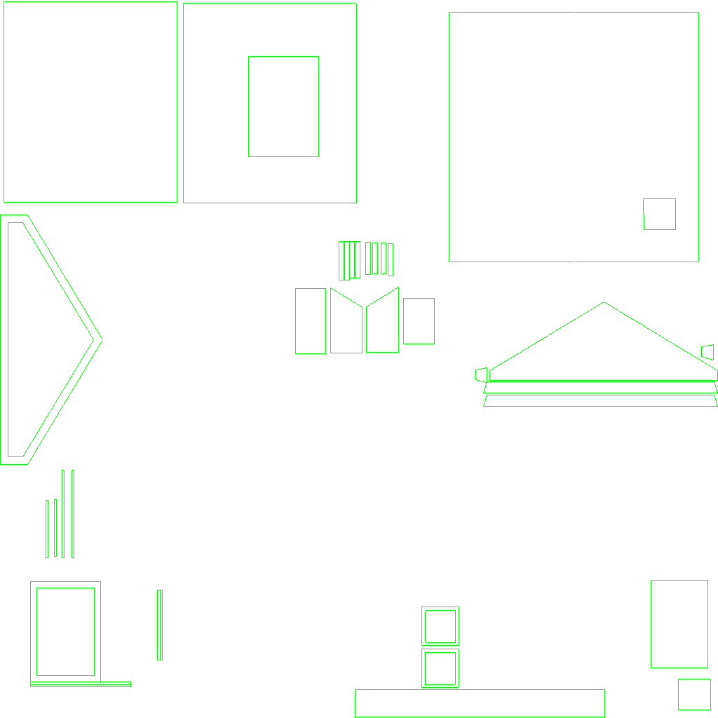
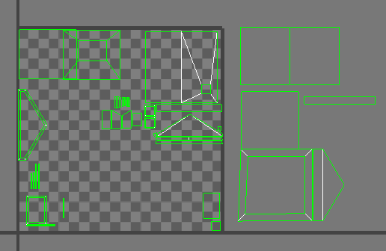
Texturing
File Types:
.png
.tif
.psd
Texturing has 2 main stages:
UV Unwrapping
Materials and Maps
I will go over one instance of UV Unwrapping a model and then one instance of making a material for a model.
UV Unwrapping
EXAMPLE: BASIC HOUSE MODEL
This is my final UV map for the main house model. While it has too much open space, it contains all parts of the model that will be visible to the player at the intended viewing angle of the game. To the right is an image showing the extra polygons that do not need to be textured as they are not intended to be shown. This is just one of the UV maps used for this model, and on the next slide I will show the others as well as talk about some techniques used to create them,

Slide 7
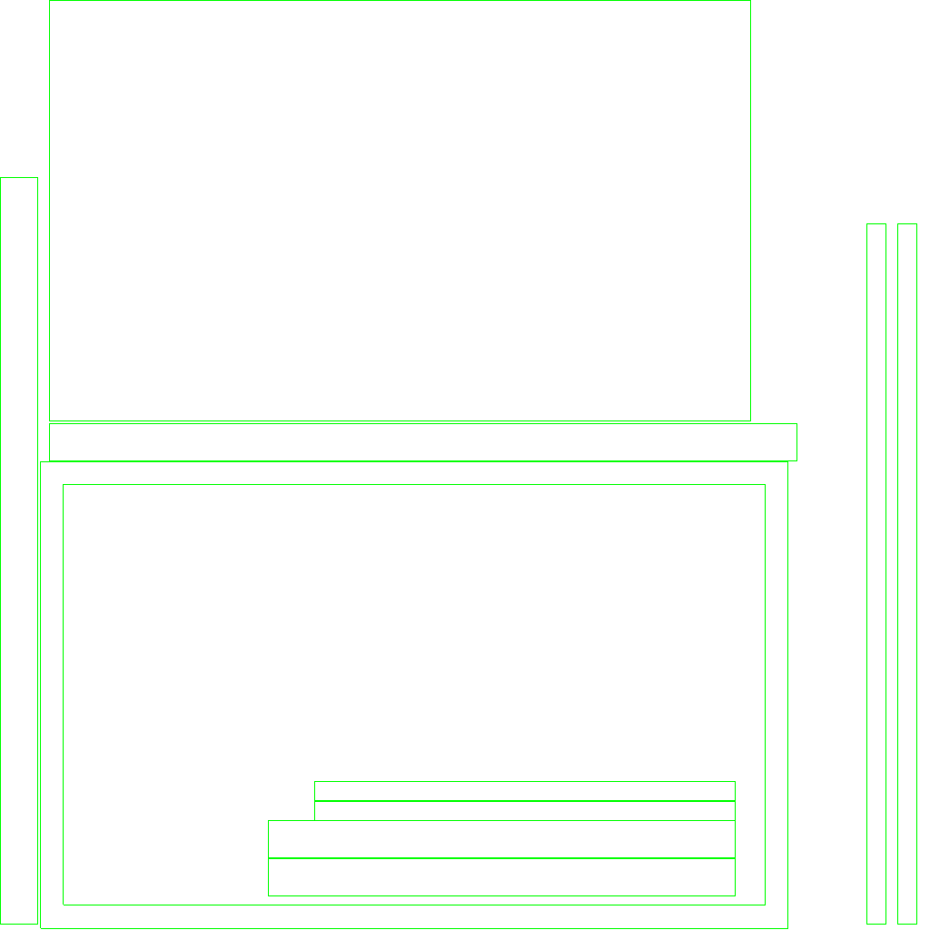
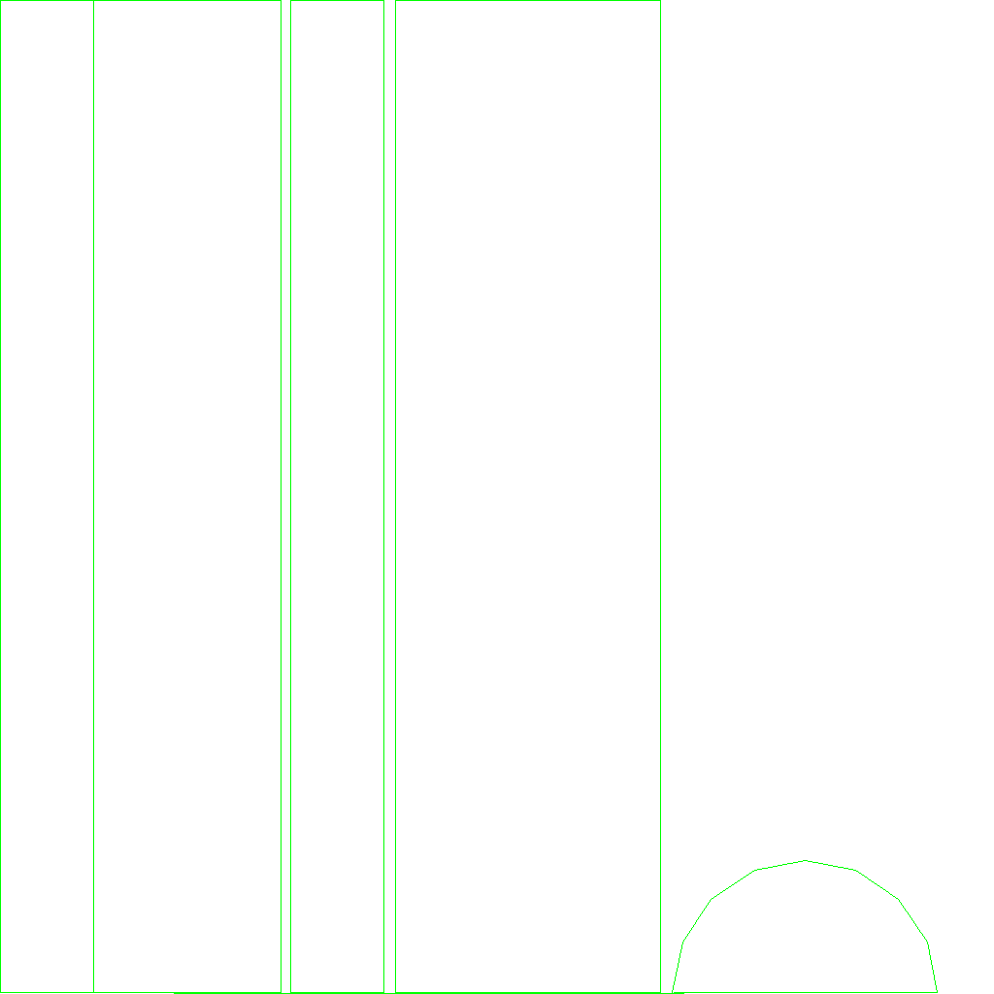
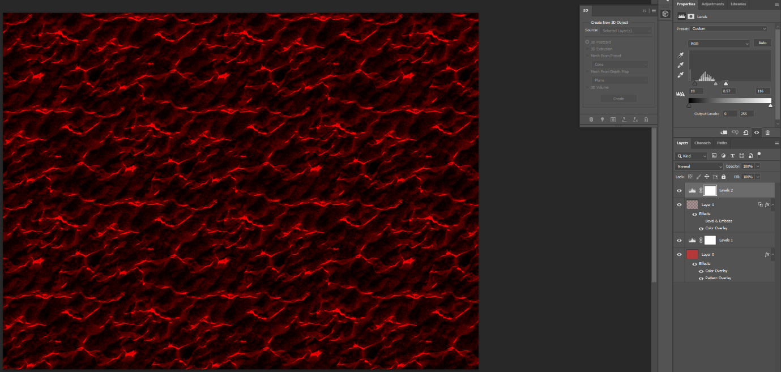
To the left is the UV Map of the door for my hut and to the right is the UV Map of the pieces of wood that sit outside of the house. When using the UVW Unwrap I had to use a few tools to make sure that the UV Maps came out correctly. To start, I selected all the polygons and used the Flatten Mapping tool to make sure all polygons were spread out, and then I started to move, rotate and scale them to fit what I needed within the map. I needed to break edges using the break tool and weld some using the weld tool.
Materials and Maps
EXAMPLE: CHARACTER MODEL
This is the Colour Map for my character model. It is made from 4 layers, one being the main texture, two to change set the levels of colours that are shown and one that is an overlayed layer to slightly change the colour of the layers underneath it. This formed a texture that I will use for a lava creature.

Slide 8
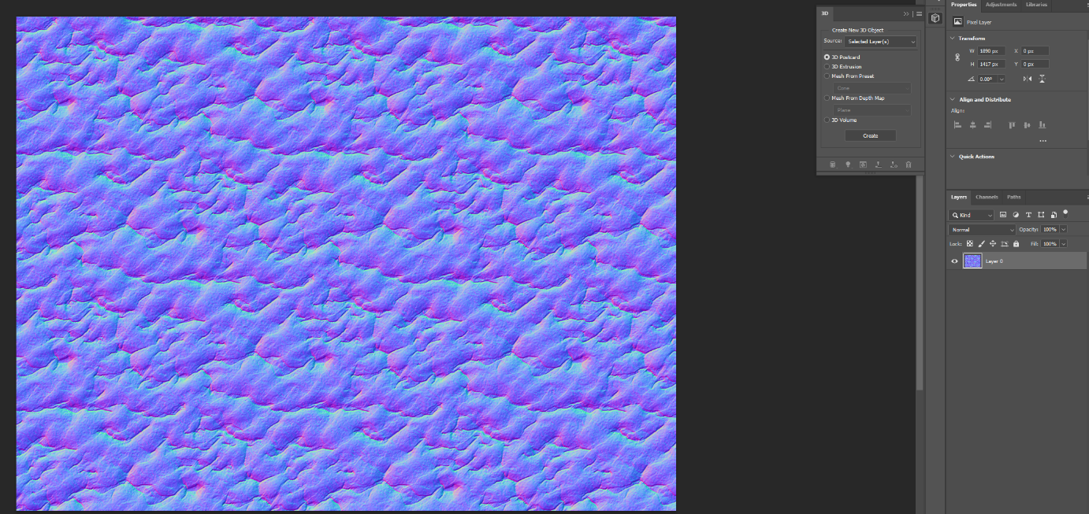
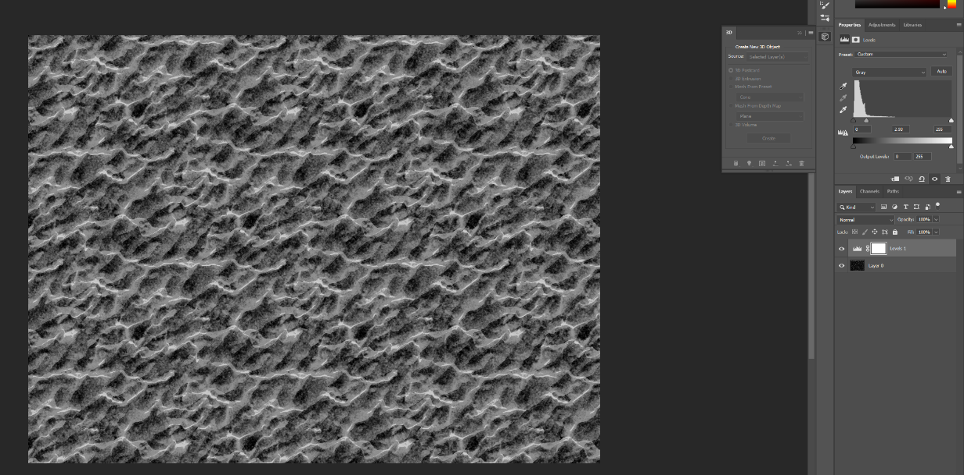
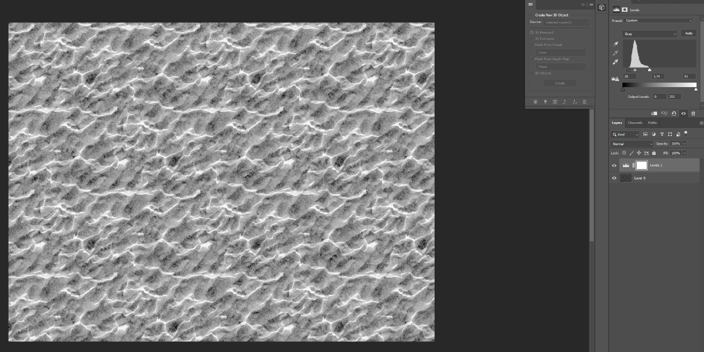
This is my Normal map. It was made by applying the Normal Map filter to my Colour map in Photoshop.
This is my Ambient Occlusion map. It was made by turning my Colour map into a greyscale image and then applying a layers filter and moving everything towards the darker side.
This is my Roughness map. It was made in a similar way to the Ambient Occlusion map, however things are more skewed towards lighter colours instead.

Slide 9
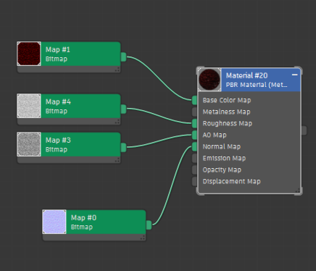
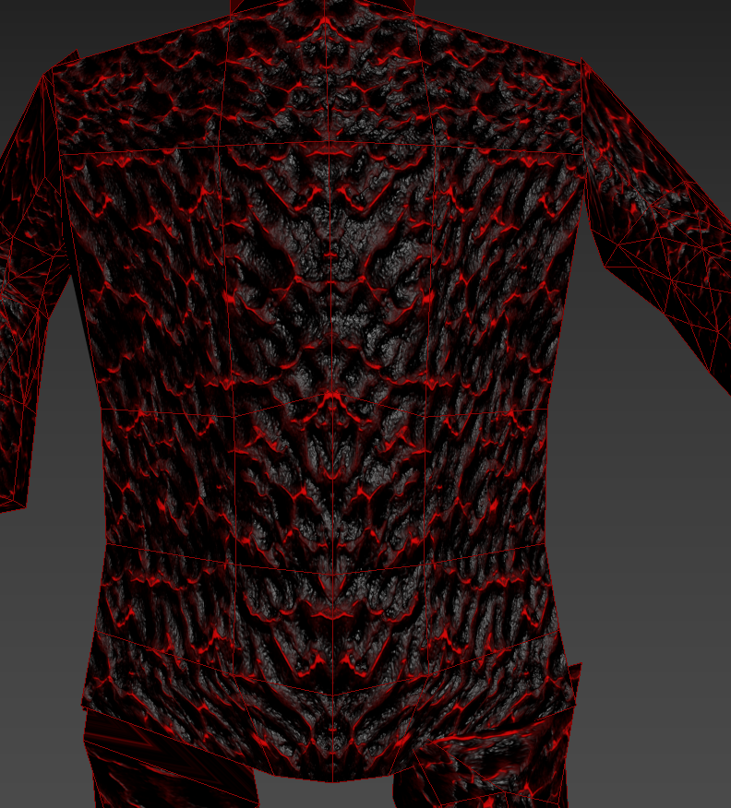
Final Product
I plugged all of these maps into a simple material for textures with a metalness/roughness map option, and the final result came out looking very good for what I was aiming for in my opinion.
Because of the way I modelled the character, the texture is mirrored in the center meaning that there are not visible tears in the texture in any easily visible areas.

Slide 10
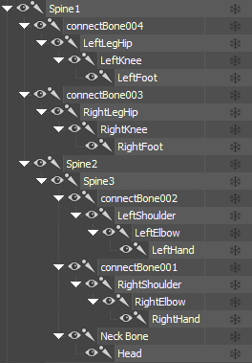
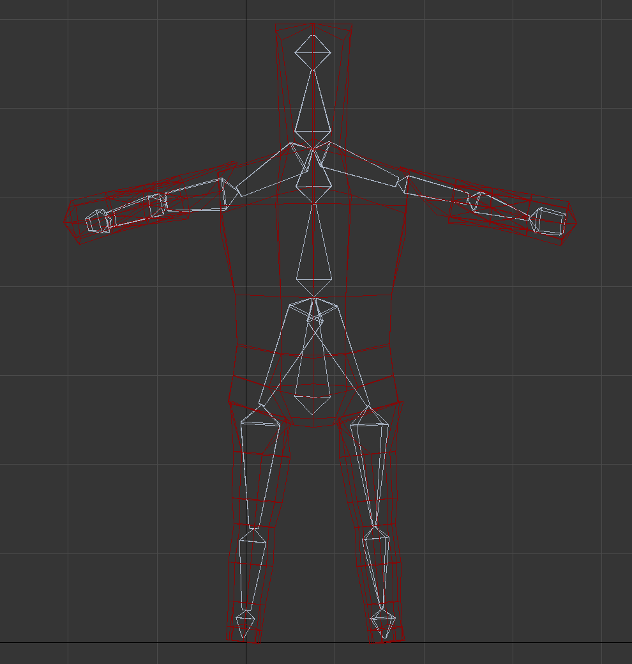
Animation
File Types:
.max
To start with animation, I had to use 3DS Max’s built in bone system. At first I tried with the built in Biped system, however after some trial and error I decided that it would be better to create my own skeleton.
Using the bone creation tools, I made 5 separate parts to my skeleton. The Torso, Left Arm, Right Arm, Left Leg and Right Leg. Then in the hierarchy I made sure to name each bone to make things easier as I continued.
I used the bone tools to control the sizes of different parts of the bones to make sure that they all fit neatly within the model while still moving everything. (Width, Height and Taper)
I added Connect Bones to allow the different parts of the skeleton to work together when I moved any part of the skeleton to ensure that any other bones moved correspondingly if they needed to.

Slide 11
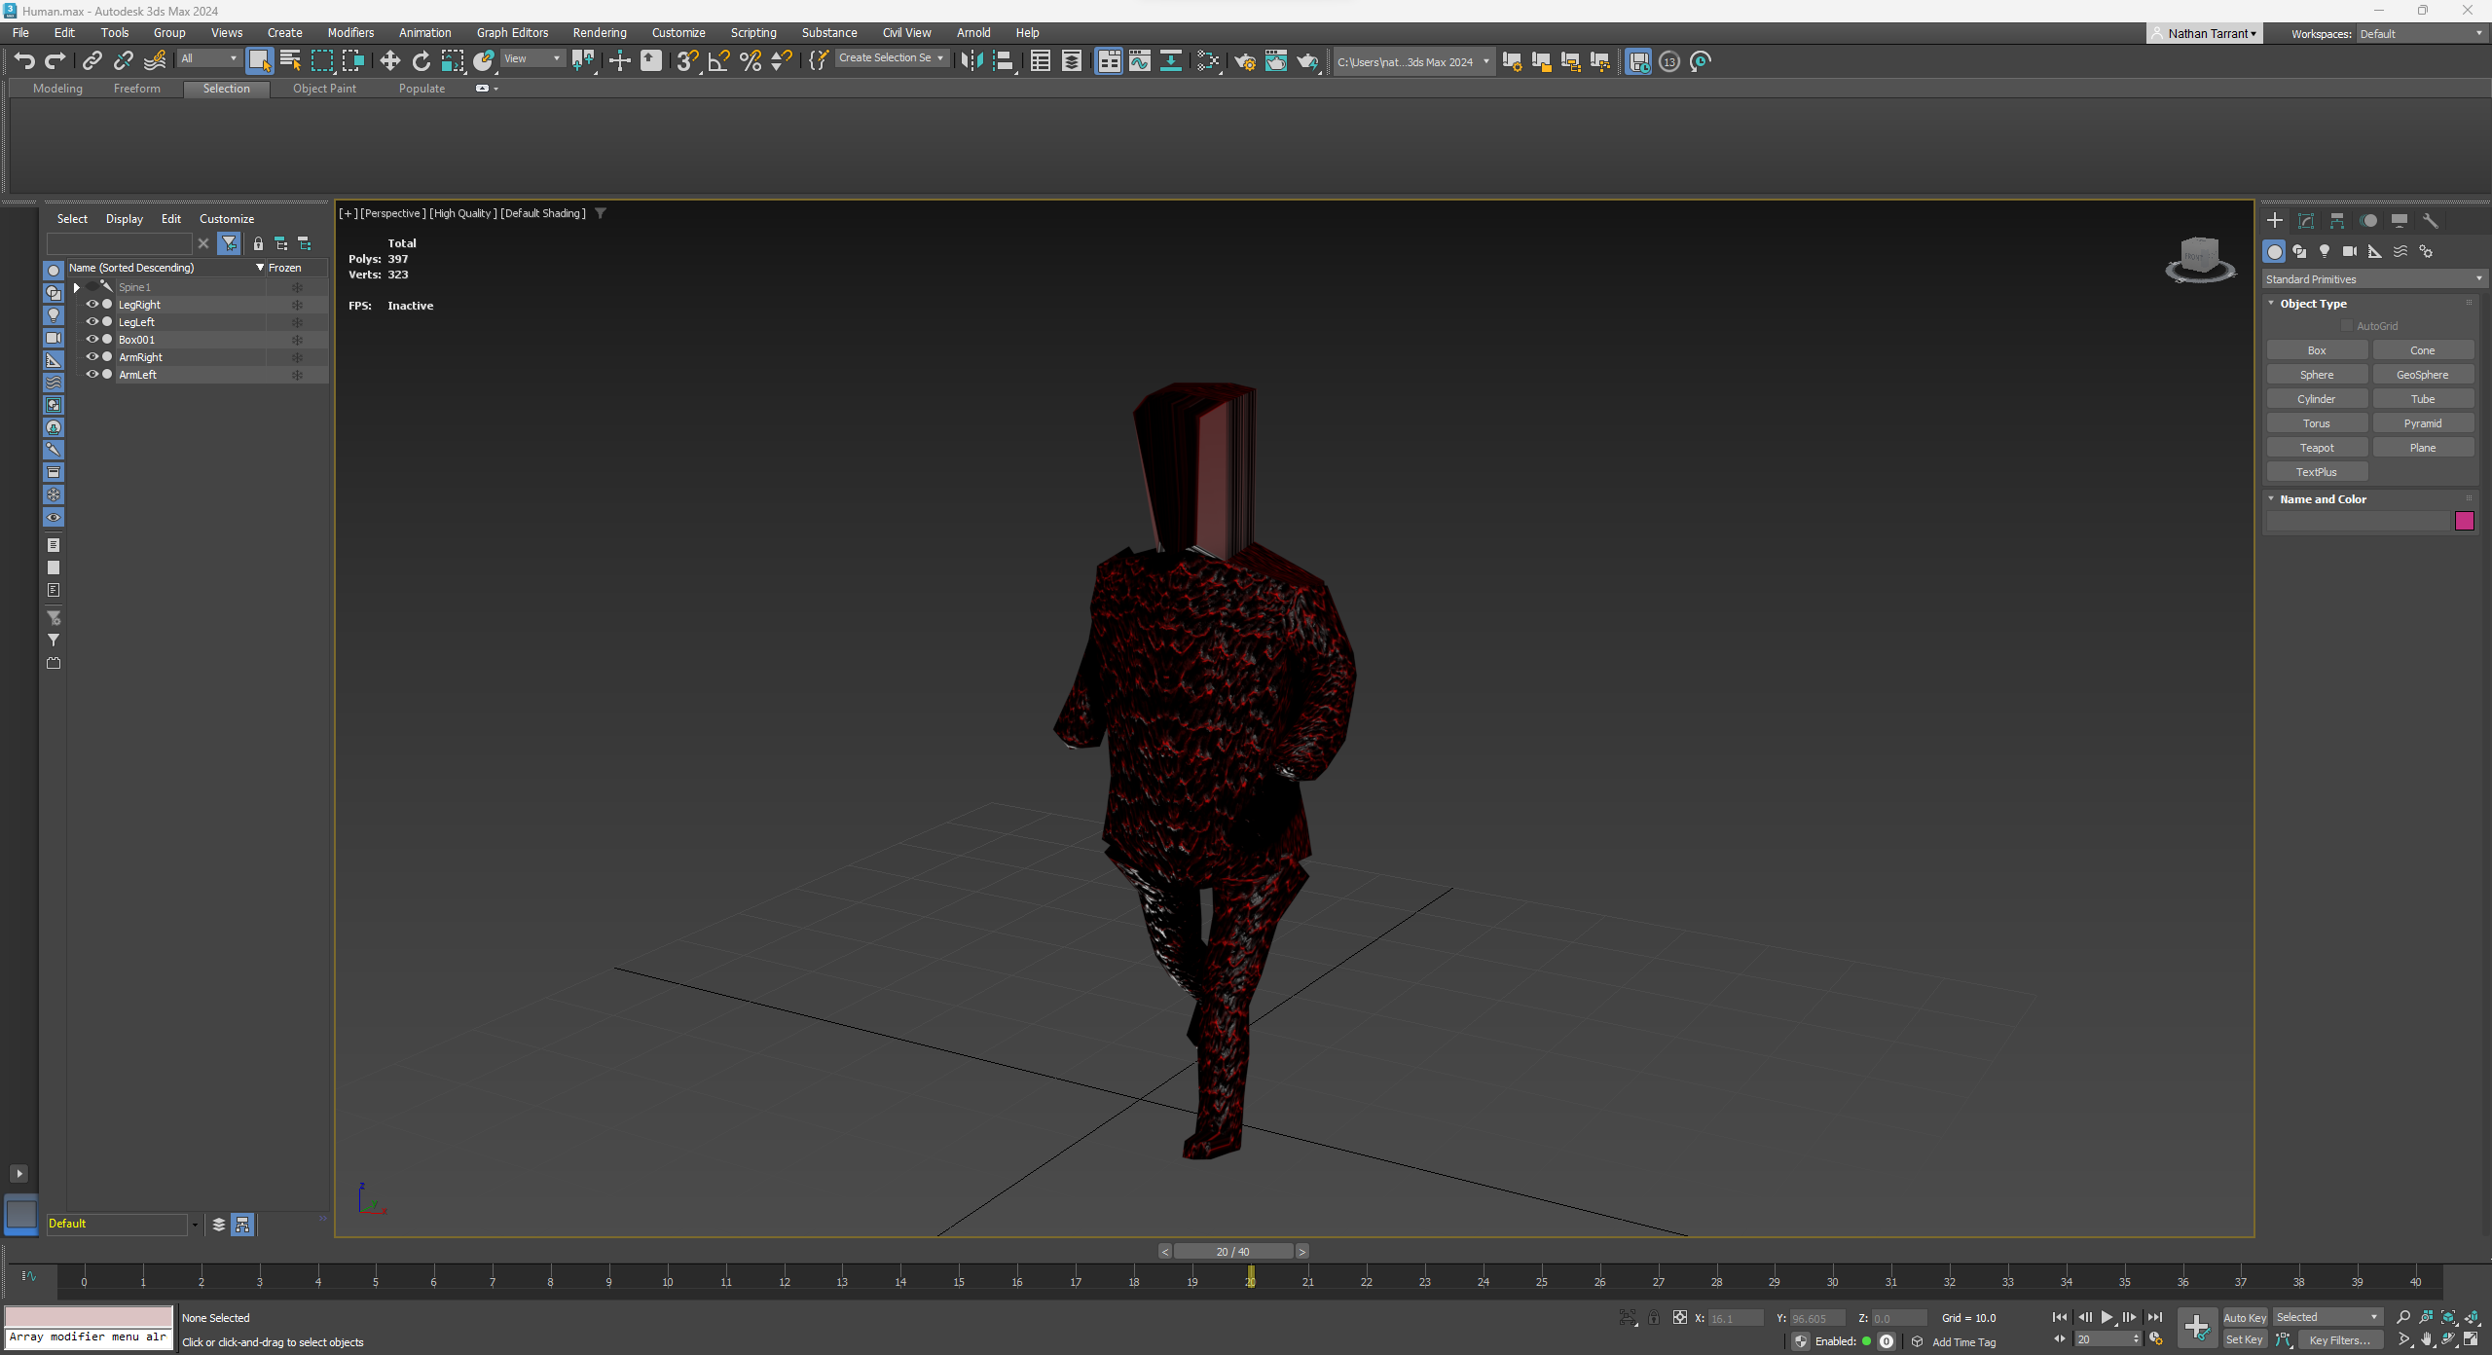
Then I used Mesh Skinning to add bones to the correct body parts. This made it so that moving any of the bones would simultaneously make the body move with it, setting me up to complete my animation.
Using AutoKey, I moved each bone into position for the frame and then when finished with it I moved which frame I was working on in the slider at the bottom of 3ds Max.

Slide 12
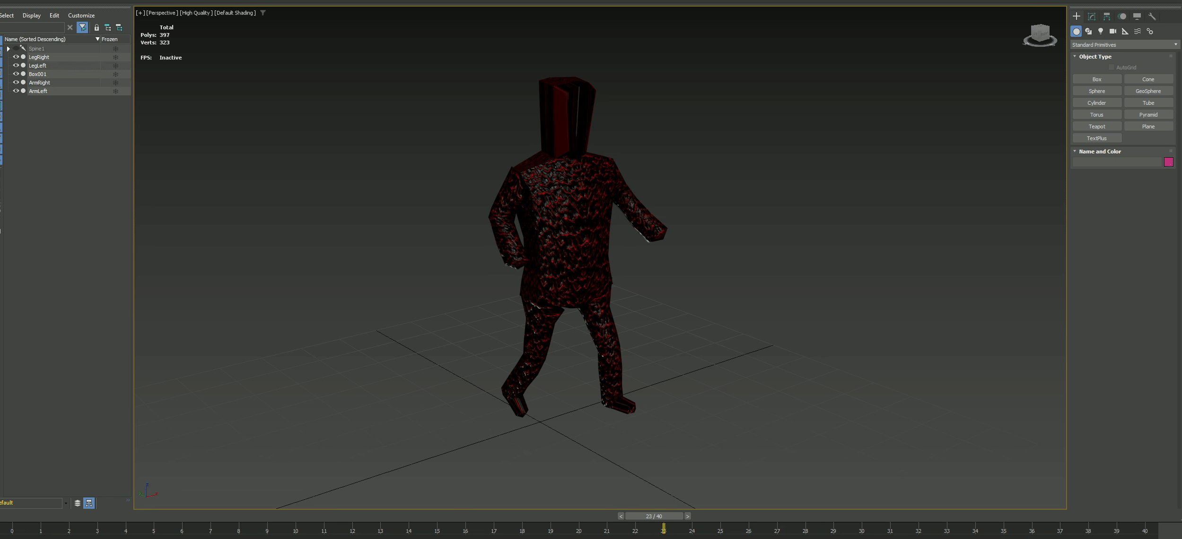
3ds Max automatically fills in the frames between these keyframes, moving each bone into the places they would be in the interval frames allowing for quick animation.
This is a GIF of the final animation.

Slide 13
Level design
For the enemy territory, the difficulty is set by 2 factors:
Starting Area
The size of the area that the enemy player or AI starts with ‘control’ of, determined by what area their starting buildings can spawn in.
Number of Buildings
The number of buildings that the enemy player starts with, if it is higher then they will have more units to be able to expand and create warriors with.
When wanting to increase difficulty, I can increase the number of starting buildings and/or the size of the starting area to give the other player an advantage.
For the levels, I need to think about what makes the difficulty of a Populous level. I have split it down into a few areas.
Terrain
Enemy Starting Territory
Level Hazards
For terrain, the difficulty is determined by how flat the players area is. If there are less flat plains then the player will need to do more to be able to create new buildings and areas. This means that I can make a level more difficulty by simply adding more hills and dips or by making hills and dips larger and exist at more extreme heights, such as 4-5 sections tall instead of 2-3 for an easier level.
Level Hazards encompasses a large variety of things and would, in most cases, affect both players. So while not increasing difficulty only for our player, it does increase the complexity of the game.

Slide 14
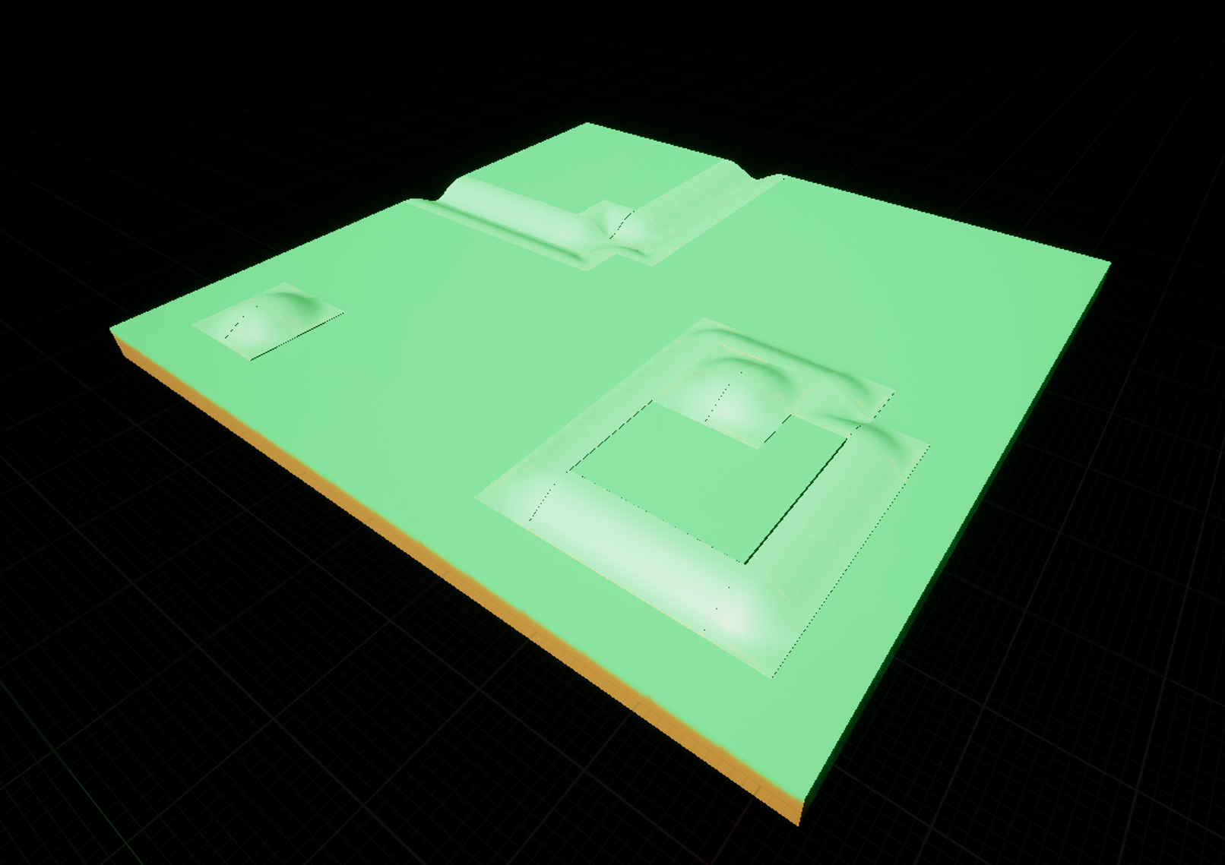
Easy Level Design
An easy level should have:
A small enemy starting area.
A low number of enemy buildings.
More flat terrain on the players side.
Little to no level hazards.
This is a very rough draft of an area of an easy level made in Unreal Engine using my own assets. It uses very little in the terms of hills and divots, with lots of flat space inbetween existing landmarks. In theory, the player would spawn on the end furthest away from the camera where there is only one divot, allowing them plenty of space to expand and giving them a very easy start to learn the basics of changing the terrain around them.

Slide 15
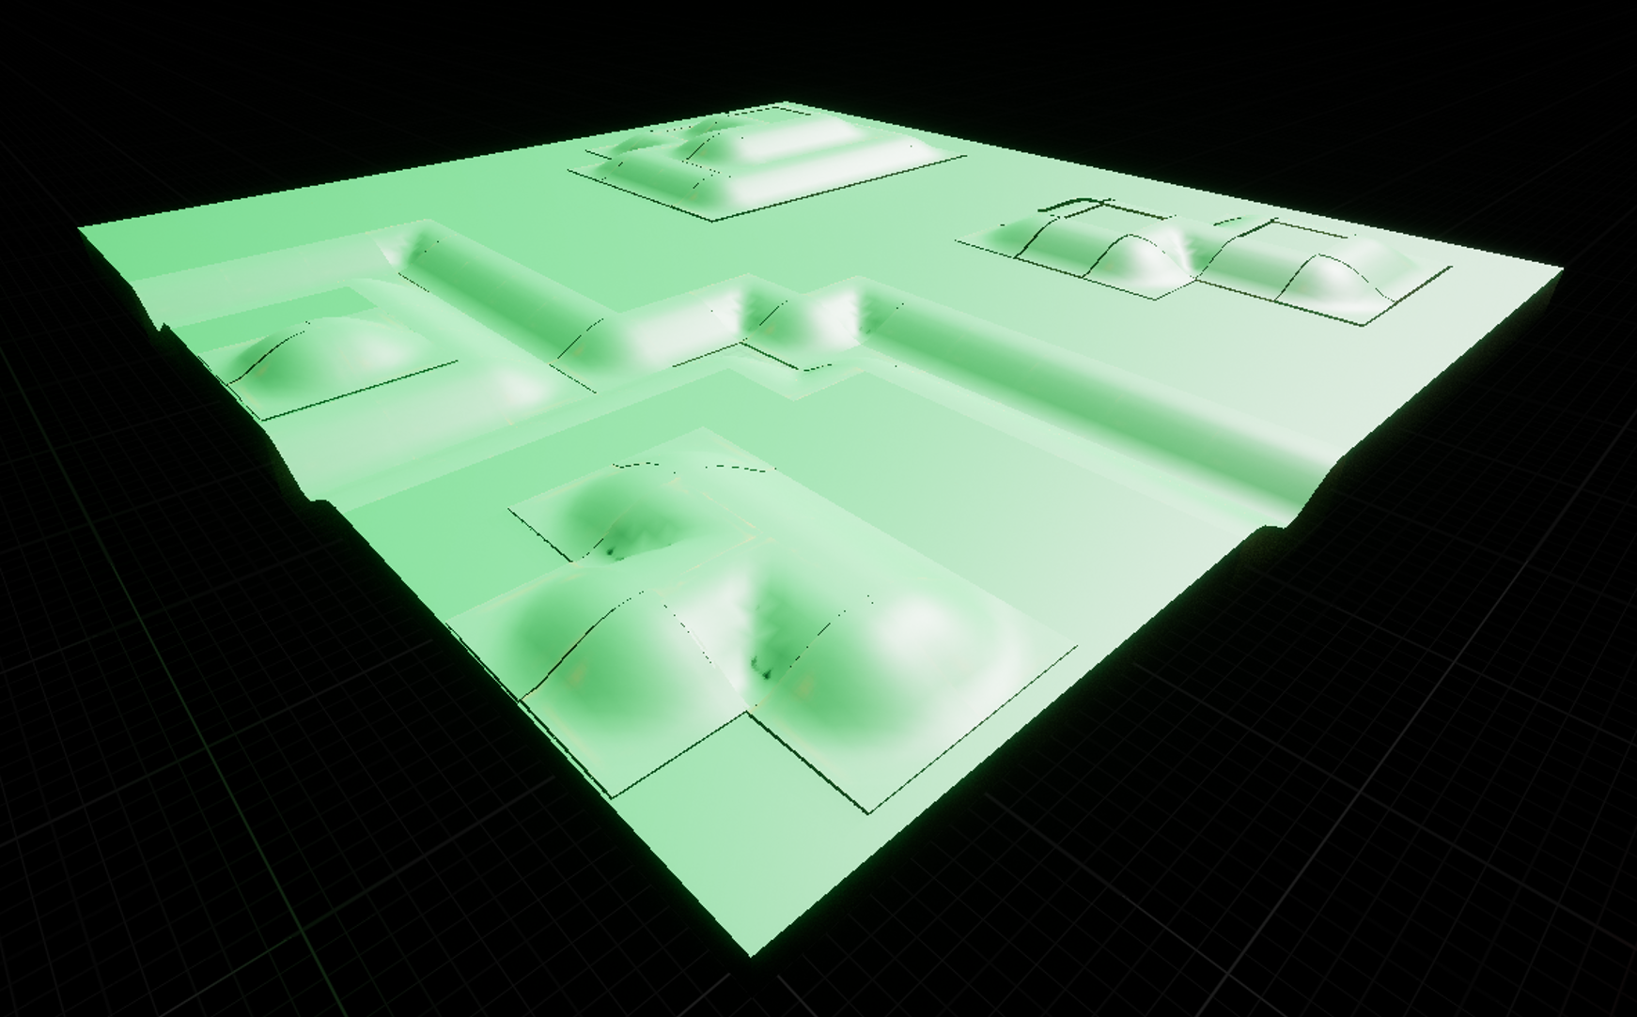
Difficult Level Design
This level does not need to be difficult, it is designed to show a progression in difficulty compared to the first level. There are a few ways I will show a progression in difficulty. These include:
Increasing the amount of hills and divots in the level.
Making the enemies spawn area flatter.
Include level hazards.
I have taken these into account and made a second concept area for a more difficult level in Unreal Engine.
This is an expanded version of the easy level design, with extra hills and divots. While I have not added any level hazards this level should provide a steady increase in difficulty compared to the first level. Here no matter where the player spawns it would provide a similar level of difficulty.

Slide 16
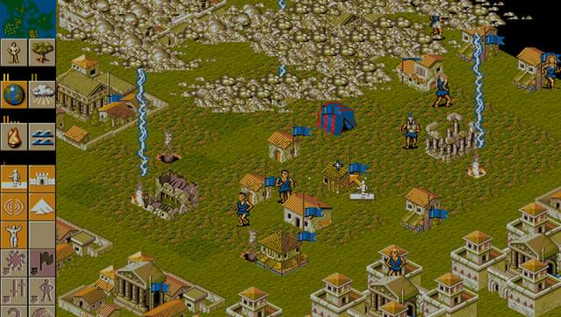
audio
File Types:
.wav
For my audio I have decided to create a lightning sound effect. I will record a sound, edit the sound in audacity and then import it into Unreal Engine 5.
I decided on a lightning sound effect as I will be able to use it at a later point in this series of modules relating to Populous 2. The game features godly powers that can greatly affect your gameplay and I can use this lightning strike sound effect for one of the God powers that is similar to a ‘Smite’ or bolt of lightning to destroy buildings.
The game also features the ability to summon lightning storms, which this sound effect could also be used for. The images on the right show parts of the game where these effects would be used.

